Slide 1
IMF group meeting
10/20/2018
Leihong

Slide 2
Outlines
Updated framework for the whole project
Section a. Text recognition
Section b. Text-based similarity search
Section c. image-based similarity search / image registration
Project updates
Leihong’s Updates
Evan’s Updates (separated slides)

Slide 3

Updated framework
Reference
Product
Database
Extracted Text Info
1. Scene text detection and recognition
3.1 Image pre-processing
Human
Rx drug
2. Text similarity search
Top N similar images
ID | IMG-S | Text-S
11 | 95% | 88%
6 | 86% | 95%
3 | 77% | 66%
.. | .. | ..
7 | 45% | 43%
Processed test image
Candidates w/image
3.2 Image similarity search
Algorithms
Ranked Similar images
Expected Outcome

Slide 4
Summary
1. Scene text detection and recognition
Expected Outcome: Extracted Text Info
2. Text similarity search
Expected Outcome: Candidates w/image
3.1 Image pre-processing
Expected Outcome: Processed test image
3.2 Image similarity search
Expected Outcome: Ranked Similar images
Motivations
Optical Character Recognition (OCR) may not work well to extract texts from a captured object image;
Using Keywords and alternative texts is quite popular in reverse image searches such as google image;
Directly doing image similarity search for millions of historical image is impossible due to computational costs;
Image pre-processing (e.g., image registration) is a key-step in optimizing model performance

Slide 5
Project updates
Evan’s updates
Setup GPU working environment (separated slides)
Leihong’s updates
Image registration
image similarity research approaches

Slide 6
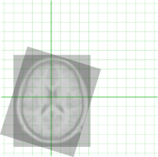
Image registration approach
Image registration (or image alignment) is the process of transforming different sets of data into one coordinate system.
Features
Registration usually between two images (i.e., source and target);
Usually two images are similar before doing registration/alignment;
Could be intensity-based:
Intensity patterns via correlation metrics
Or feature-based:
Correspondence between points, lines, etc.
https://github.com/topics/image-registration
Registration of two MRI images of the brain

Slide 7
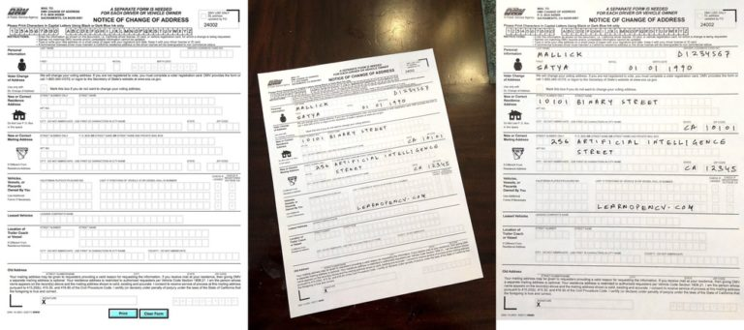
Regular image registration
Left: A form downloaded from the Department of Motor Vehicles (DMV). Center: The filled out DMV form photographed using a mobile phone. Right: The result of aligning the mobile photo (center) to the original template (left).

Slide 8
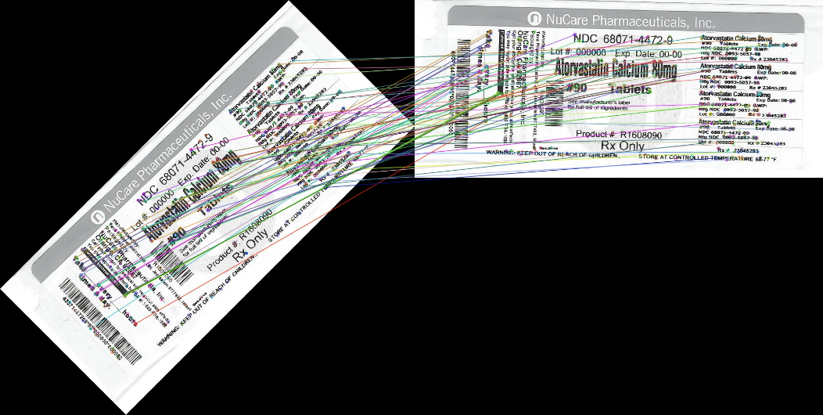
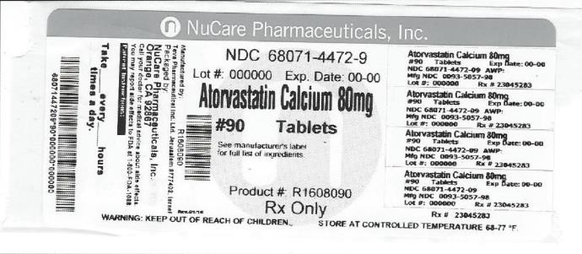
Pilot study on image registration
Solve rotated issues
We used the SAME image (previous rotated) for the pilot study testing
Input (test image)
reference image
Output (test image)

Slide 9
Image similarity analysis
Hash mapping (pHash, aHash, wHash, dHash, etc.)
Keypoint Matching
SIFT keypoints
Already implemented in Image registration
Deep learning based matching
Unsupervised (autoencoder)
Pre-trained image model (ImageNet, etc.)

Slide 10


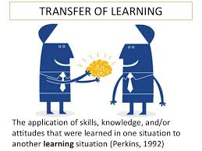
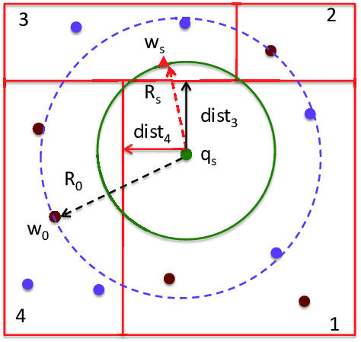
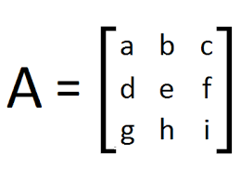
Image similarity analysis
Similarity analysis
alignment
Pre-trained CNN
Image pre-processing (registration)
……
Test Product
(Image)
Featured vectors
Distance
a k-d tree (short for k-dimensional tree, a quick nearest neighbor lookup algorithm) is a space-partitioning data structure for organizing points in a k-dimensional space
Top ranked* Reference Product
(Image)
L1/2; Kmeans; Kdtree; etc.

Slide 11
Pilot Study on Image analysis
Pilot dataset (5 categories with similar images; total 35 pcs)
Pilot study on image alignment/registration
Pilot study on image similarity analysis

Slide 12
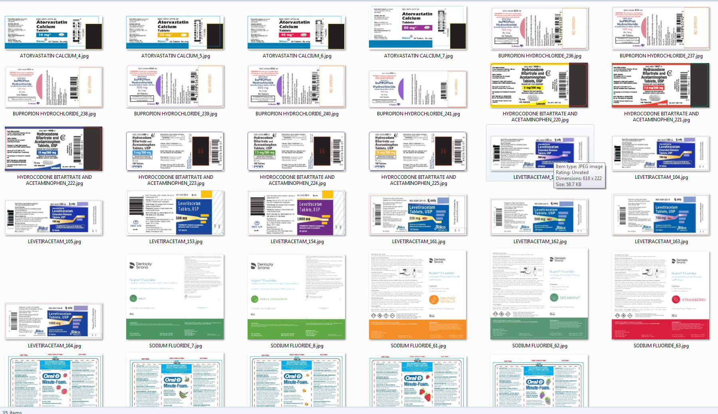
Pilot Study data

Slide 13
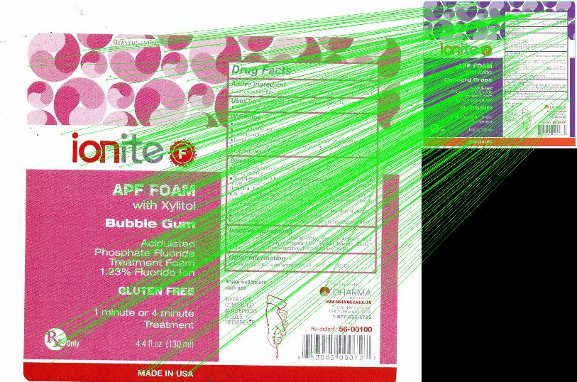
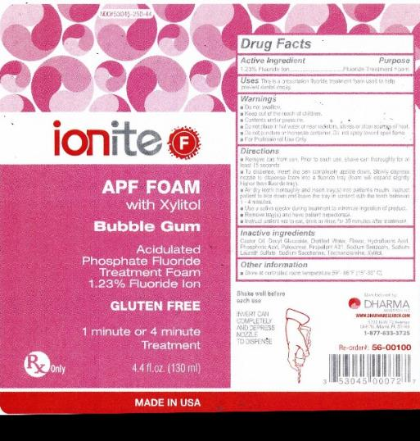
Pilot registration study
on different (but similar) images
Green lines indicate the matching pairs
Aligned image

Slide 14

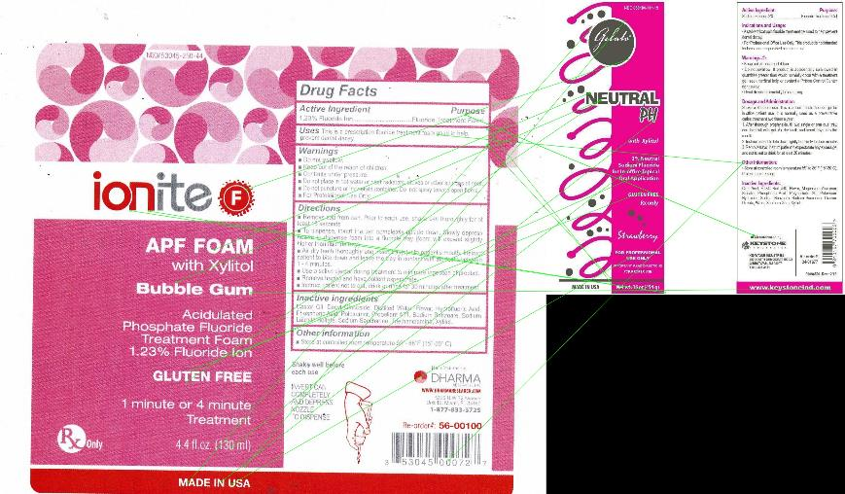
Pilot registration study
on different images
Aligned image is difficult to understand as the machines is confused.
green lines are quite messy

Slide 15
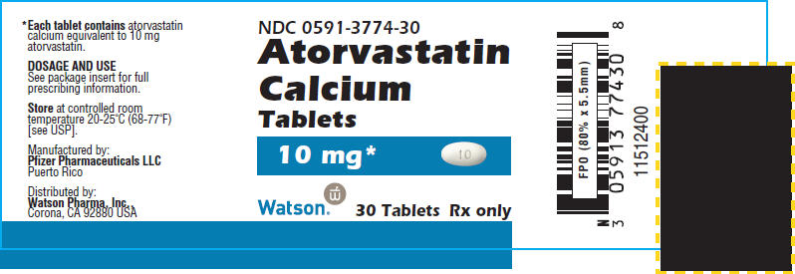
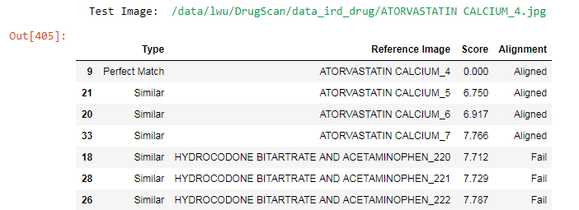
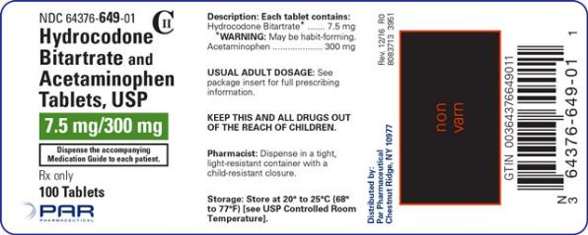
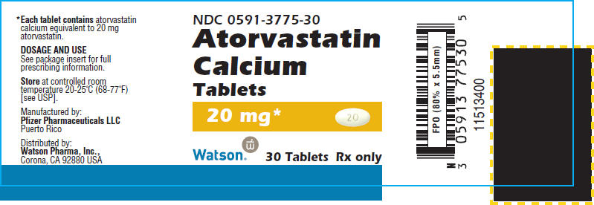
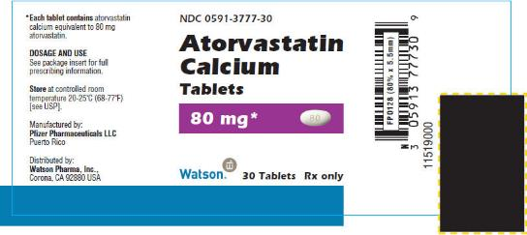
Image analysis
ATORVASTATIN CALCIUM_4
HYDROCODONE BITARTRATE AND ACETAMINOPHEN_224
ATORVASTATIN CALCIUM_5
ATORVASTATIN CALCIUM_7

Slide 16
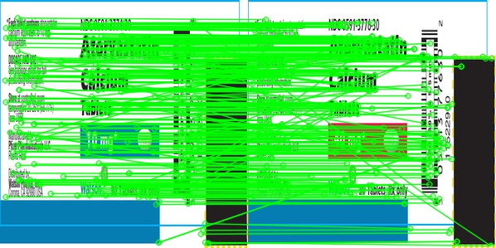
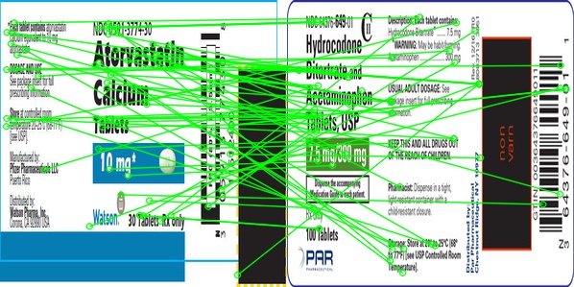
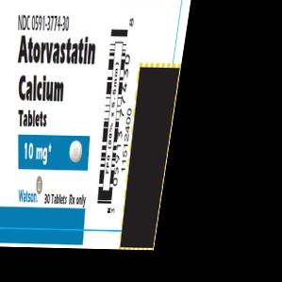
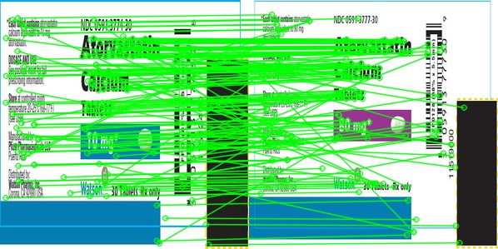
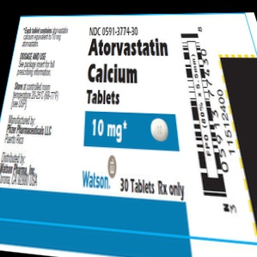
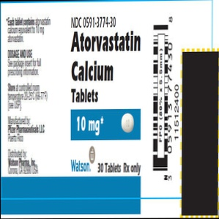
Image registration effects:
Inputs
ATORVASTATIN CALCIUM_6.jpg
HYDROCODONE BITARTRATE AND ACETAMINOPHEN_224
Outputs
Inputs
ATORVASTATIN CALCIUM_7.jpg
Outputs
Outputs
Inputs

Slide 17
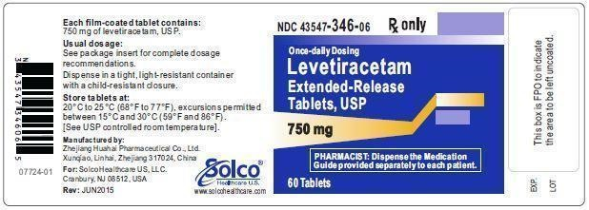
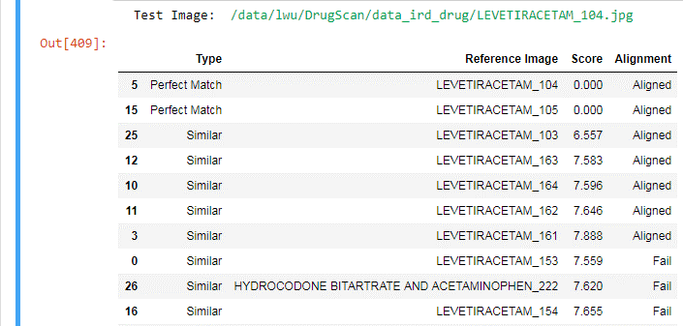
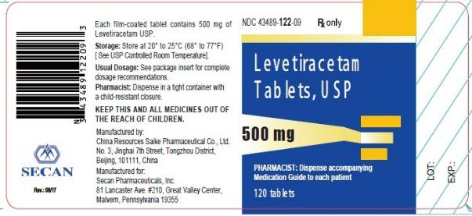
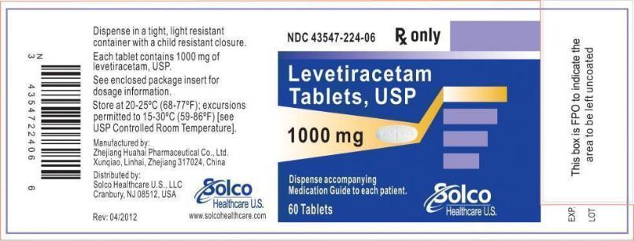
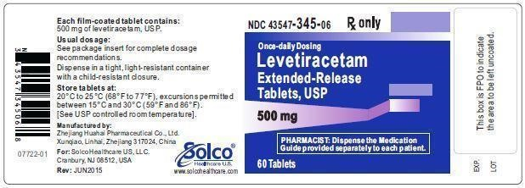
Pilot result:
LEVETIRACETAM_104.jpg
LEVETIRACETAM_153
LEVETIRACETAM_164
LEVETIRACETAM_103

Slide 18
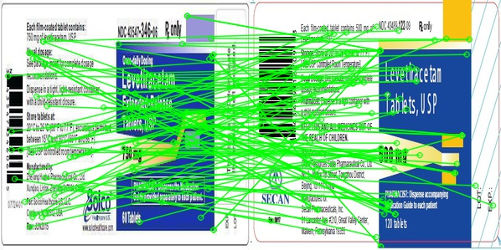

Sometime Image registration does not work well:
input
Reference
Output

Slide 19
Future plan
Evan:
Leihong:
Image pre-processing
Image analysis
Evaluate different hash algorithms;
Evaluate different deep-learning architectures;

